Slide 1
Consensus Introduction to Byzantine Fault Tolerance Problems
Jiasun Li

Slide 2
Consensus algorithm (simplified)
New transactions are broadcast to all nodes
Each node collects new transactions into a block
In each round a random node gets to broadcast its block
Other nodes accept the block only if all transactions in it are valid (unspent, valid signatures)
Nodes express their acceptance of the block by including its hash in the next block they create

Slide 3
Consensus protocols
Byzantine generals Problem
Two generals problem
Agreement/broadcasting problem; State-machine replication
Nakamoto consensus
pBFT: practical Byzantine Fault tolerance protocol
HotStuff (Libra-BFT/Diem)
Tendermint, etc. (Cosmos, Substrate, Polkadot)

Slide 4
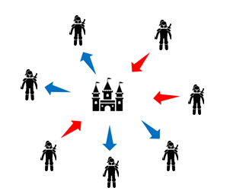
Byzantine generals Problem

Slide 5
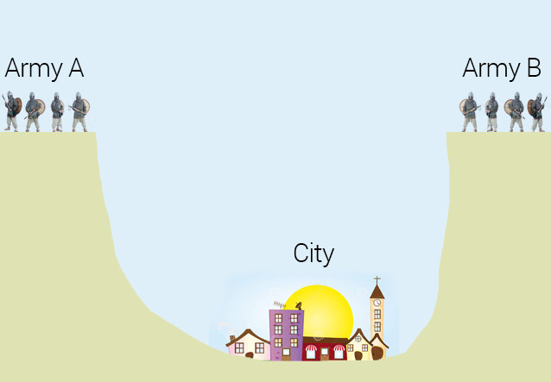
Two generals problem

Slide 6
Higher-order belief/knowledge

Slide 7
Higher-order belief/knowledge

Slide 8
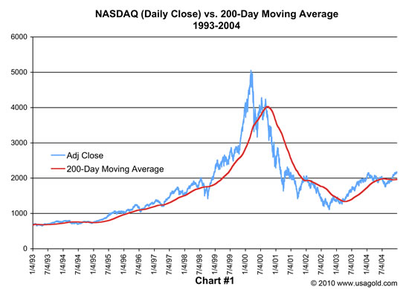
Higher-order belief/knowledge

Slide 9
The problem
n nodes, among which f nodes are faulty
The Agreement problem
$n$nodes; each has an input $v_{i}$ in a known set $V$. A protocol s.t.:
Agreement: no two honest nodes decide on different values.
Validity: if all honest nodes have the same $v$ then $v$ is decided.
Termination: all honest nodes eventually decide on a value in $V$.
The Broadcast Problem
A leader node has some input $v$. A protocol s.t.:
Agreement: no two honest nodes decide on different values.
Validity: if the leader is honest then $v$ is the decision value.
Termination: all honest nodes eventually decide on a value in $V$.
State machine replication (SMR); safety and liveness

Slide 10
Examples
Simple problems if common knowledge that
All messages sent are received in a known fixed time
Nodes always work properly (no crashing or lying)
What if messages can be delayed?
Synchrony, asynchrony, partial synchrony, etc.
What if some nodes can be faulty?
Threshold adversary: at most $f$ faulty nodes out of $n$
What if nodes are strategic?

Slide 11
Communication model
Synchrony:
There exists some known finite time bound $\text{Δ}$ s.t. any message sent can be delayed by at most $\text{Δ}$
Asynchrony:
A message sent can be delayed by any finite amount of time i.e. a message must eventually be delivered but no bound exists on the delivery time
Partial synchrony:
There exists some known finite time bound Δ and a special event called GST (Global Stabilization Time) such that:
The GST event must happen after some unknown finite time
Any message sent at time $t$ must be delivered by $\text{Δ}\text{+}\text{max}\text{(}\text{t}\text{,}\text{GST}\text{)}$
Source: Decentralized Thoughts by Ittai Abraham adapting DLS88 (somehow differs from DLS88 from my reading…)

Slide 12
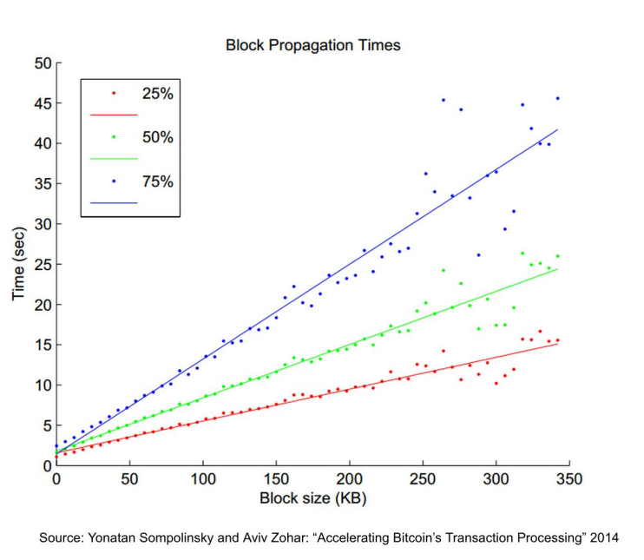

Slide 13
Fault Models
Type of corruption
Crash: stop sending and receiving messages
Omission: drop or allow messages sent or received
Byzantine: arbitrary actions
(Typically) bounded computational power:
Cannot forge signatures or invert hashes
Full information vs. private channels
Adaptivity:
Static: adversary decides which $f$ nodes to corrupt before protocol execution.
Adaptive: adversary decides dynamically as the protocol progresses who to corrupt based on what it learns over time.
How long it takes between the adversary decision to corrupt and the event that the control is passed to the adversary? A standard assumption of instantaneous, other options see here.

Slide 14
Some possibility/impossibility results
$∀f<n$ Byzantine Agreement possible under synchrony (Pease, Shostak, & Lamport, 1980)
$∀n≤3f$ Byzantine Agreement impossible under partial synchrony (Dwork, Lynch, & Stockmeyer, 1988)
$∀f>1$, crash Agreement impossible under asynchrony (Fischer, Lynch, & Paterson, 1985)

Slide 15
Synchrony
f<n: f+1 rounds of communication

Slide 16
$∀n≤3f$ Byzantine Agreement impossible under partial synchrony

Slide 17
$∀n≤3f$ Byzantine Agreement impossible under partial synchrony

Slide 18
$∀n≤3f$ Byzantine Agreement impossible under partial synchrony

Slide 19
Recent BFT development in Blockchain
Tendermint (Buchman, 2016)
BFT in the Age of Blockchains
Casper (Buterin and Griffith 2017)
Casper the Friendly Finality Gadget
Hot-Stuff (AGM 2018)
Hot-Stuff the Linear One-Message BFT Devil

Slide 20
BFT Consensus
$\text{n}\text{=3}\text{f}\text{+1}$
authenticated communication channels
agreement, eventual termination, validity
partial synchrony
eventually known bound ∆
safety maintained against asynchrony
liveness during synchronous periods

Slide 21
Libra-BFT
Adaption of HotStuff
My understanding: marrying BFT and NC

Slide 22
Libra (Diem)
A “stablecoin” solution
Like MakerDAO, Tether, GUSD, USDC, etc.
(so far) a permissioned system with 21 nodes
Folded last year
Moving onto Aptos

Slide 23
An Economic Model of Consensus on Distributed Ledgers
Hanna Halaburda, NYU Stern
Zhiguo He, Chicago Booth and NBER
Jiasun Li, George Mason

Slide 24
Byzantine Fault Tolerance (BFT) in blockchains
A classic problem
A resurgence of interest
Trusted $⇒$ adversarial environments
Notes:
We are taking an economics lens at this stuff and ask how it will affect the performance of the system in equilibrium

Slide 25
Byzantine Fault Tolerant (BFT) protocols
Classic problem in computer science (since Lamport, Shostak, Pease `82)
Distributed computer nodes communicate with each other to …
Reach consensus based on “local” information (no “global” knowledge)
Byzantine nodes behave arbitrarily
Stipulate “honest” strategies for non-Byzantine nodes
Widely used in tech companies to maintain distributed databases

Slide 26
Byzantine Fault Tolerant (BFT) protocols
Classic problem in computer science (since Lamport, Shostak, Pease `82)
Distributed computer nodes communicate with each other to …
Reach consensus based on “local” information (no “global” knowledge)
Byzantine nodes behave arbitrarily
Stipulate “honest” strategies for non-Byzantine nodes
Widely used in tech companies to maintain distributed databases
This paper (given that blockchains live in trustless environments)
Non-Byzantine nodes are rational
Ambiguity averse (Knightian uncertain) about Byzantine strategies

Slide 27
Consensus game
A game among a measure of n computer nodes:
Nature randomly selects one node as the leader;
Denote all other nodes as backups;
Leader decides, for each backup, whether to send a message;
e.g. new batch of transactions in a blockchain; problem.oblem.
Each backup receiving message from leader
(if yes), for each other node, whether to forward message;
Each node then decides whether to commit to message
based on its local information set.
For simplicity, we study one round of synchronous peer communication in a single view. Lamport, Shostak and Pease (1982) study f rounds. Castro and Liskov (1999) (PBFT) study two rounds of communication with view changes. We also assume adequately close message delivery speeds to justify simultaneous moves in each step.
Notes:
In our analysis, we use a simple model. We call it a consensus game.

Slide 28
Consensus game
A game among a measure of n computer nodes:
Nature randomly selects one node as the leader;
Denote all other nodes as backups;
Leader decides, for each backup, whether to send a message;
e.g. new batch of transactions in a blockchain; problem.
Each backup receiving message from leader
(if yes), for each other node, whether to forward message;
Each node then decides whether to commit to message
based on its local information set.
For simplicity, we study one round of synchronous peer communication in a single view. Lamport, Shostak and Pease (1982) study f rounds. Castro and Liskov (1999) (PBFT) study two rounds of communication with view changes. We also assume adequately close message delivery speeds to justify simultaneous moves in each step.

Slide 29
Consensus game
A game among a measure of n computer nodes:
Nature randomly selects one node as the leader;
Denote all other nodes as backups;
Leader decides, for each backup, whether to send a message;
e.g. new batch of transactions in a blockchain;
Each backup receiving message from leader
for each other node, whether to forward message;
Each node then decides whether to commit to message
based on its local information set.
For simplicity, we study one round of synchronous peer communication in a single view. Lamport, Shostak and Pease (1982) study f rounds. Castro and Liskov (1999) (PBFT) study two rounds of communication with view changes. We also assume adequately close message delivery speeds to justify simultaneous moves in each step.

Slide 30
Consensus game
A game among a measure of n computer nodes:
Nature randomly selects one node as the leader;
Denote all other nodes as backups;
Leader decides, for each backup, whether to send a message;
e.g. new batch of transactions in a blockchain;
Each backup receiving message from leader
decides, for each other node, whether to forward message;
Each node then decides whether to commit to message
based on its local information set.
For simplicity, we study one round of synchronous peer communication in a single view. Lamport, Shostak and Pease (1982) study f rounds. Castro and Liskov (1999) (PBFT) study two rounds of communication with view changes. We also assume adequately close message delivery speeds to justify simultaneous moves in each step.

Slide 31
Consensus game
A game among a measure of n computer nodes:
Nature randomly selects one node as the leader;
Denote all other nodes as backups;
Leader decides, for each backup, whether to send a message;
e.g. new batch of transactions in a blockchain;
Each backup receiving message from leader
decides, for each other node, whether to forward message;
Each node then decides whether to commit to message
based on its local information set.
For simplicity, we study one round of synchronous peer communication in a single view. Lamport, Shostak and Pease (1982) study f rounds. Castro and Liskov (1999) (PBFT) study two rounds of communication with view changes. We also assume adequately close message delivery speeds to justify simultaneous moves in each step.

Slide 32
Two types of nodes
Measure f of Byzantine nodes, who may take arbitrary actions;
Measure n−f of rational nodes, who maximize utilities:
Consensus succeeds iff “almost all” (measure n−f) rational nodes commit
A dynamic game of imperfect info. w/ “cheap talk” &“coordination”
Solution concept:
perfect Bayesian eqm + multi-priors over Byzantine strategies
 | if consensus on message
 | Succeeds | Fails
Commit to message | R > 0 | -c < 0
Not commit to message | 0 | 0

Slide 33
Two types of nodes
Measure f of Byzantine nodes, who may take arbitrary actions;
Measure n−f of rational nodes, who maximize utilities:
Consensus succeeds iff “almost all” (measure n−f) rational nodes commit
A dynamic game of imperfect info. w/ “cheap talk” &“coordination”
Solution concept:
perfect Bayesian eqm + multi-priors over Byzantine strategies
?
 | if consensus on message
 | Succeeds | Fails
Commit to message | R > 0 | -c < 0
Not commit to message | 0 | 0
?
?
?

Slide 34
Two types of nodes
Measure f of Byzantine nodes, who may take arbitrary actions;
Measure n−f of rational nodes, who maximize utilities:
Consensus succeeds iff “almost all” (measure n−f) rational nodes commit
A dynamic game of imperfect info. (“coordination” & “cheap talk”)
Solution concept:
perfect Bayesian eqm + multi-priors over Byzantine strategies
?
 | if consensus on message
 | Succeeds | Fails
Commit to message | R > 0 | -c < 0
Not commit to message | 0 | 0
?
?
?

Slide 35
Ambiguity aversion
Rational nodes are ambiguity averse towards Byzantine strategies
“assume worst case scenario”
Formally, a rational node $i$ at any information set $I_{i}$ facing all possible Byzantine strategies in $ℬ$ chooses action a_{i} to maximize
$$\min_{B∈ℬ}{Ε[u_{i}(a_{i}, A_{−i};B)|I_{i}]}$$
if $∃$ a Byzantine strategy profile consistent with $I_{i}$ such that a positive measure of rational nodes does not commit, then $i$ will not commit

Slide 36
Characterizing all symmetric equilibria
Consider a candidate symmetric equilibrium in which
a rational leader sends message to each backup with prob. p
a rational backup forwards message (if received) with prob. q
a backup commits iff receiving
k ∈ $E^{1}$⊂ [0, (n − f) q + f] messages, with one from the leader; or
k ∈ $E^{0}$⊂ [0, (n − f) q + f] messages, none of which is from the leader.
If $E^{1}∪E^{0}=∅$, then a gridlock equilibrium (failed consensus)
Our interest is in (successful) consensus equilibrium with p > 0 and q > 0
Notes:
Our contribution here is interpreting blockchain BFT protocols withing economics framework, so that we can derive further insights and implications. First thing we do is to characterize all symmetric equilibria in this simple model. We start with what could be a candidate symmetric equilibrium, and then we pin down conditions under which it exists.

Slide 37
Inferences
about the leader
$$\left(n−f\right)pq+fp$$
#msg a rational backup receives
$$\left(n−f\right)pq$$
$$\left(n−f\right)q+f$$
Notes:
In any candidate equilibrium, a node can make a couple of inferences from the # of messages it received

Slide 38
$$\left(n−f\right)q+f$$
about other rational nodes
#msg another backup receives
$$\left(n−f\right)pq+fp$$
#msg a rational backup receives
$$\left(n−f\right)pq$$
$$\left(n−f\right)q+f$$
Notes:
also, given the # of received messages, a node can make inferences about # other nodes received

Slide 39
$$\left(n−f\right)q+f$$
about other rational nodes
$$f$$
if the leader is Byzantine
Byzantine nodes can coordinate:
Deliver any number of msgs in this range with perfect precision
#msg another backup receives
$$f$$
$$\left(n−f\right)pq+fp$$
#msg a rational backup receives
$$f$$
$$\left(n−f\right)pq$$
$$\left(n−f\right)q+f$$
Notes:
Since Byzantine nodes can coordinate, all other rational nodes may get anywhere between -f and +f than me (with the constraint that the number of messages is between 0 and (n-f)q+f), and Byzantine nodes can deliver any number in that range with perfect precision

Slide 40
$$\left(n−f\right)q+f$$
if the leader is rational
$$fp$$
#msg another backup receives
$$f$$
$$\left(n−f\right)pq+fp$$
#msg a rational backup receives
$$f$$
$$\left(n−f\right)pq$$
$$\left(n−f\right)q+f$$

Slide 41
The properties of a consensus equilibrium
A consensus equilibrium has
$$E^{1}∪E^{0}=[\left(n−f\right)pq,\left(n−f\right)pq+fp]$$
A rational backup who knows the leader is Byzantine
always gets −c from committing to message…
thus does not commit to message
except for when $p=1$ and she receives exactly $k=\left(n−f\right)q+f$ messages

Slide 42
)
$$\left(n−f\right)pq+fp$$
#msg a rational backup receives
$$f$$
$$\left(n−f\right)pq$$
$$\left(n−f\right)q+f$$
Notes:
These inferences allow the nodes to make commit decisions.
We use iterated deletion of dominated strategies to find out.

Slide 43
)
$$\left(n−f\right)pq+fp$$
#msg a rational backup receives
$$f$$
$$\left(n−f\right)pq$$
$$\left(n−f\right)q+f$$

Slide 44
)
$$\left(n−f\right)pq+fp$$
#msg a rational backup receives
$$f$$
$$\left(n−f\right)pq$$
$$\left(n−f\right)q+f$$

Slide 45
)
)
$$\left(n−f\right)pq+fp$$
#msg a rational backup receives
$$f$$
2$f$
$$\left(n−f\right)pq$$
$$\left(n−f\right)q+f$$

Slide 46
)
)
$$\left(n−f\right)pq+fp$$
#msg a rational backup receives
$$f$$
2$f$
$$\left(n−f\right)pq$$
$$\left(n−f\right)q+f$$

Slide 47
…
$$\left(n−f\right)pq+f$$
)
$$\left(n−f\right)pq+fp$$
)
)
#msg a rational backup receives
$$f$$
2$f$
$$\left(n−f\right)pq$$
$$\left(n−f\right)q+f$$

Slide 48
$$\left(n−f\right)pq+f$$
)
$$\left(n−f\right)pq+fp$$
)
)
#msg a rational backup receives
$$f$$
2$f$
$$\left(n−f\right)pq$$
$$\left(n−f\right)q+f$$

Slide 49
…
$$\left(n−f\right)pq+f$$
)
$$\left(n−f\right)pq+fp$$
)
)
#msg a rational backup receives
$$f$$
2$f$
$$\left(n−f\right)pq$$
$$\left(n−f\right)q+f$$

Slide 50
??
$$\left(n−f\right)pq+fp$$
#msg a rational backup receives
$$\left(n−f\right)pq$$
$$\left(n−f\right)q+f$$

Slide 51
Need to characterize conditions for reward/penalty $R$ and $c$ under which it is indeed preferred to commit in this interval
$$\left(n−f\right)pq+fp$$
#msg a rational backup receives
$$\left(n−f\right)pq$$
$$\left(n−f\right)q+f$$

Slide 52
All symmetric equilibria
A “gridlock" equilibrium: discard communications and never commit
Interval-$E^{0}$-equilibria indexed by $p,q∈(0,1]$ when $\frac{1}{2}\left(n−f\right)R≥fc$:
A rational leader sends message to each backup with prob. $p∈[\frac{fc}{\left(n−f\right)R}\text{, 1−}\frac{fc}{\left(n−f\right)R}\text{]}$;
A rational backup forwards message (if received) with prob. $q∈(0,1]$;
A rational backup commits iff receiving $k∈[\left(n−f\right)pq,\left(n−f\right)pq+fp]$ messages, receiving from the leader or not, i.e. $E^{0}=E^{1}=[\left(n−f\right)pq,\left(n−f\right)pq+fp]$
Singleton-$E^{0}$-equilibria indexed by $q∈(0,1]$ when $\left(n−f\right)R≥fc$:
A rational leader sends message to each backup with $p=1$;
A rational backup forwards message (if received) with prob. $q∈\left(0,1\right]$;
A rational backup commits iff receiving $k∈[\left(n−f\right)q,\left(n−f\right)q+f]$ messages, with one from the leader or $\left(n−f\right)q+f$messages without any from the leader, i.e. $E^{1}=\left[\left(n−f\right)q,\left(n−f\right)q+f\right]$ and $E^{0}=\{\left(n−f\right)q+f\}$.

Slide 53
Message losses
All messages sent are delivered with prob. 𝛼 < 1
A “gridlock” equilibrium still exists
Singleton-$E^{0}$-equilibria no longer exist
Interval-$E^{0}$-equilibria require higher $R/c$ to sustain for small $α$
Supporting $R/c$ regions expands as message loss prob. $α$decreases

Slide 54
Implications
Operational success of any blockchain depends on its design.
Accounting for incentives in BFT consensus:
All designs are subject to multiple equilibria concerns
gridlock equilibria always exist ⇒ possibility of system stuck
Small probability of message loss significantly affects equilibria
Existence of consensus equilibrium depends on R and c
R and c may be restricted by the environment
… or can be within decision of the system designer

Slide 55
Relation to existing work
BFT in CS – info important but non-Byzantine nodes are honest
Lamport, Shostak and Pease (1982), Catro and Liskov (1999)
in Econ, focus mostly on PoW, PoS and delegated PoS
Budish (2018), Cong, He and Li (2021), Saleh (2021), etc.
PBF work in Econ – cost of sending messages
Amoussou-Guenou, Biais, Potop-Butucaru and Tucci-Piergiovanni (2020), Auer, Monnet and Shin (2021)

Slide 56
Our contribution
An economic framework to analyze incentives in BFT protocols
Guidance for maintaining reliable distributed ledgers among self-interested parties
Focus on information imperfection, rather than, say, operating costs
Intrinsic to the challenges faced by distributed systems

